Slide 1





Arkansas Minor consent and Confidentiality Laws
SPARK
For educational purposes only
Updated June 2026
© 2026 Regents of the University of Michigan
Notes:
Today we are going to do a 15-minute mini-training, also called a Spark. As youth-serving professionals, it is important that we understand adolescent confidentiality and minor consent. Each person here will have times where we need to know and comply with confidentiality laws, though it’s different for our various roles. For each law and scenario we discuss, try think about how it applies to your role specifically. To get us started, let’s review a case scenario.

Slide 2

Case Scenario: SHAY, 15 Y/O girl
Purpose of visit
Sore throat
Issue that emerges from clinician interview
Concerned about having a Sexually Transmitted Infection (STI)
Parent information
Shay says she is worried her mother will kick her out of the house if she knows Shay is sexually active
Can the provider screen Shay for STIs without her mother’s consent? Why or why not?
Notes:
This is Shay who is 15. She is here today because of a sore throat. During her visit the clinician found out that she is concerned about having a STI. Shay says she is worried her mother will kick her out of the house if she knows Shay is sexually active. How does the right to confidentiality help or hurt Shay?
[Give participants a moment to respond to the question on the slide. You may choose to have discussion here or just have people think about it.]
Usually, not all of this patient information is available to everyone who comes into contact with her. When we know more details about a patient, does it affect how we feel about the patient’s right to confidentiality? Even though we know the law says we need to respect teens’ confidentiality, it can be challenging when we think parents should be involved. What can go wrong if we accidentally break confidentiality?
[Have a couple of people respond briefly. Main point: If we don’t follow the laws, it can have a negative impact on teens.]
Many teens choose to include their parent or guardian in decisions about their health. For some teens, however, having the option of certain confidential services makes it more likely that they will seek care when they need it. For instance, a sexually active teen may be more likely to use contraception if someone tells the teen that they can get birth control without a parent or guardian’s consent.

Slide 3
AR Law: Parental Consent Exceptions
In Arkansas, a parent or legal guardian can generally consent to health care on behalf of a minor. However, there are several circumstances when minors can consent to their own care:
  Care for married or emancipated minors
  Care related to pregnancy and childbirth, and certain sexual and reproductive services
  Care for an unemancipated minor who is able to understand the consequences of proposed treatment
Notes:
Let’s review the laws and consider how we implement them here. In Arkansas, a parent or legal guardian and generally consent to health care on behalf of a minor. However, there are several circumstances when minors can consent to their own care:
Care for married or emancipated minors
Care related to pregnancy and childbirth, and certain sexual and reproductive services
Care for an unemancipated minor who is able to understand the consequences of proposed treatment
[Pass out the “Arkansas Confidentiality/Minor Consent Laws” handout.]

Slide 4
AR Law: Confidentiality/minor Consent
Arkansas law allows minors to consent to certain health care services without parental/guardian consent:
  Care related to pregnancy and childbirth, except abortion
  Birth control information and contraceptives
  Testing and treatment for sexually transmitted infections (STIs), including HIV
  Other medical care when the minor is able to understand the consequences of the treatment
Notes:
Here’s a handout that explains Arkansas’ confidentiality and minor consent laws. This slide also outlines the laws and can be a cheat sheet if you want to keep it handy. As we see here, Arkansas law allows minors to consent to certain health care services without parental/guardian consent. Keep in mind that a minor’s ability to consent does not necessarily mean the care will remain confidential from a parent/guardian:
Care related to pregnancy and childbirth, except abortion
Birth control information and contraceptives
Testing and treatment for sexually transmitted infections (STIs), including HIV
Other medical care when the minor is able to understand the consequences of the treatment
Are there any questions?

Slide 5
AR law: Confidentiality/Minor Consent for PrEP
Minors may be able to consent to PrEP under Arkansas’s general minor consent law
Federal requirements may also apply to PrEP provided through certain federally funded family planning programs
Notes:
Here is some additional information about prescribing PrEP for adolescent patients in Texas
Minors may be able to consent to PrEP under Arkansas’s general minor consent law
Federal requirements may also apply to PrEP provided through certain federally funded family planning programs

Slide 6
Case Scenario: SHAY, 15 Y/O girl
Purpose of visit
Sore throat
Issue that emerges from clinician interview
Concerned about having a Sexually Transmitted Infection (STI)
Parent information
Shay says she is worried her mother will kick her out of the house if she knows Shay is sexually active
Can the provider screen Shay for STIs without her mother’s consent? Why or why not?
Notes:
Let’s go back to our 15-year-old patient scenario, Shay. Let’s answer these questions together as I read through them.
Can Shay receive STI testing without a parent’s permission? [Answer: Yes]
Can she receive STI treatment? [Answer: Yes]
What if Shay was 13 years old? Answer: [Yes, she still could. Arkansas law does not specify a minimum age for a minor to consent to STI care. Providers should also assess whether the circumstances require a report of suspected child maltreatment.]

Slide 7
AR Law: Reporting
Health care providers must override the minor’s confidentiality and report if:
  There is reasonable cause to suspect child maltreatment, including sexual abuse
  Disclosure may also be necessary when there is a serious or imminent threat to the minor or someone else
Minors need a parent/guardian’s permission for:
Vaccines, unless the minor is otherwise legally able to consent
Mental health medications and inpatient mental health treatment, depending in the circumstances
Abortion, which is currently prohibited in Arkansas except when necessary to save the life of a pregnant person in a medical emergency
Notes:
Now we’re going to review when a provider may need to break confidentiality or make a report. Health care providers must follow Arkansas mandatory reporting laws when there is reasonable cause to suspect child maltreatment.
There is reasonable cause to suspect child maltreatment, including sexual abuse
Disclosure may also be necessary when there is a serious or imminent threat to the minor or someone else
Confidentiality rules depend on the type of care provided. For STI care, a physician may inform the minor’s parent/guardian about treatment given or needed but is not required to do so.
Parental/guardian consent may still be required for some services, depending on whether the minor is otherwise able to consent under Arkansas law. Additional requirements may apply to:
Vaccines, unless the minor is otherwise legally able to consent
Mental health medications and inpatient mental health treatment, depending on the circumstances
Abortion, which is currently prohibited in Arkansas except when necessary to save the life of a pregnant person in a medical emergency

Slide 8
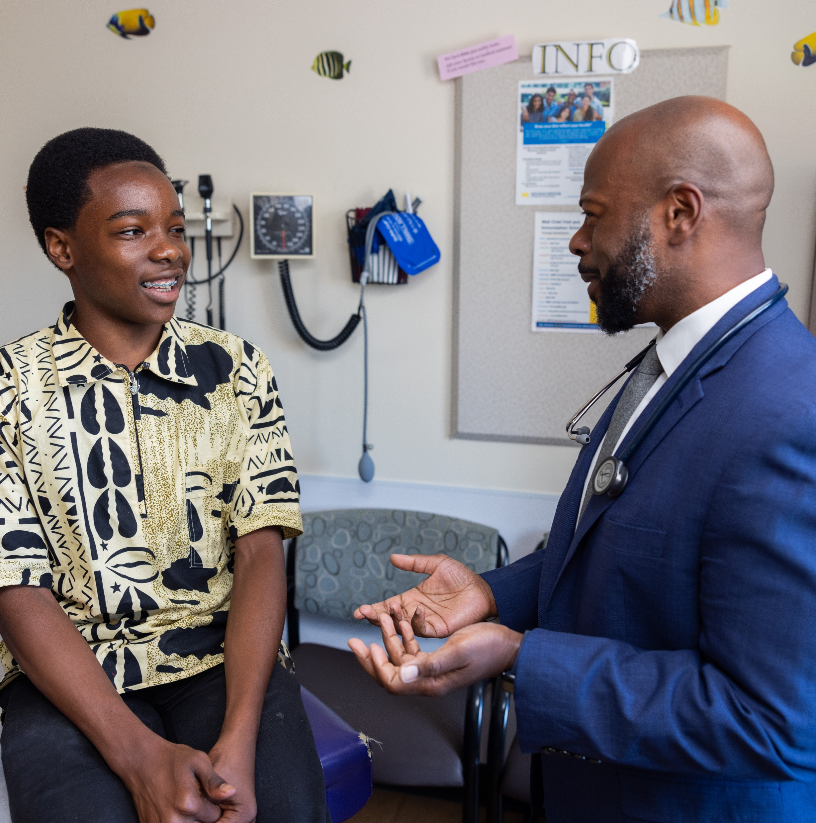
CASE SCENARIO: GIOVANNI, 17 Y/O BOY
Purpose of visit
Well visit
Issue that emerges through clinician interview
States to clinician that he’s concerned about his alcohol use
Parent information
Doesn’t want to disappoint parents
Could Giovanni be able to consent to substance use treatment without a parent’s consent?
Notes:
Let’s take a look at one last scenario. Giovanni is a 17-year-old boy who expresses concern about his alcohol use but doesn’t want to tell his parents.
Could Giovanni be able to consent substance use treatment without a parent’s consent?
[Allow a moment for people to respond either quietly to themselves or aloud.]
The answer is potentially. Arkansas law allows an unemancipated minor who is able to understand and appreciate the consequences of the proposed treatment to consent their own medical care. Additional requitements may apply depending on the type of treatment program.

Slide 9

Thank you!
© 2026 Regents of the University of Michigan
Notes:
To keep this conversation going over the next month, I will share Sparklers, or quiz questions, about confidentiality. I’ll post the Sparklers around the office in places that you all can easily see them. When you see a Sparkler, take a moment to read them and reflect on the responses. Thank you for your participation!
[Print and post Sparklers in areas your staff can see (e.g., lunchroom).]

