Slide 1








Texas Minor consent and Confidentiality Laws
SPARK
For educational purposes only
Updated June 2026
© 2026 Regents of the University of Michigan
Notes:
Today we are going to do a 15-minute mini-training, also called a Spark. As youth-serving professionals, it is important that we understand adolescent confidentiality and minor consent. This training is intended to be an overview of the most relevant laws on confidential services for teens. Texas law is complex, so if you want to do additional learning, resources are available in the facilitator guide to this Spark.
Each person here will have times where we need to know and comply with confidentiality laws, though it’s different for our various roles. For each law and scenario we discuss, try think about how it applies to your role specifically. To get us started, let’s review a case scenario.

Slide 2

Case Scenario: SHAY, 15 Y/O girl
Purpose of visit
Sore throat
Issue that emerges from clinician interview
Concerned about having a Sexually Transmitted Infection (STI)
Parent information
Shay says she is worried her mother will kick her out of the house if she knows Shay is sexually active
Can the provider screen Shay for STIs without her mother’s consent? Why or why not?
Notes:
This is Shay who is 15. She is here today because of a sore throat. During her visit the clinician found out that she is concerned about having a STI. Shay says she is worried her mother will kick her out of the house if she knows Shay is sexually active. How does the right to confidentiality help or hurt Shay?
[Give participants a moment to respond to the question on the slide. You may choose to have discussion here or just have people think about it.]
Usually, not all of this patient information is available to everyone who comes into contact with her. When we know more details about a patient, does it affect how we feel about the patient’s right to confidentiality? Even though we know the law says we need to respect teens’ confidentiality, it can be challenging when we think parents should be involved. What can go wrong if we accidentally break confidentiality?
[Have a couple of people respond briefly. Main point: If we don’t follow the laws, it can have a negative impact on teens.]
Many teens choose to include their parent or guardian in decisions about their health. For some teens, however, having the option of certain confidential services makes it more likely that they will seek care when they need it. For instance, a sexually active teen may be more likely to use contraception if someone tells the teen that they can get birth control without a parent or guardian’s consent.

Slide 3
TX Law: Parental Consent Exceptions
A parent or legal guardian must provide consent on behalf of a minor (under age 18) before health care services are provided, with several important exceptions:
Care for minors who can legally consent to their own health
Minor Consent Based on Funding Source (Medicaid or Title X)
Specific health care services related to:
  Sexual health
  Mental health and substance use treatment
Notes:
Let’s review the laws and consider how we implement them here. As we see on the slide, a parent or legal guardian must provide consent on behalf of a minor (under age 18) before health services are provided, with several important exceptions:
Care for minors who can legally consent to their own health
Minor Consent Based on Funding Source (Medicaid or Title X)
Specific health care services related to:
Sexual health
Mental health and substance use treatment
[Pass out the “Texas Confidentiality/Minor Consent Laws” handout.]

Slide 4
TX Law: Confidentiality/minor Consent
Patients under 18 have a right to the following without parental/guardian consent or knowledge:
Pregnancy-related care and prenatal care
Birth control information and contraceptives
Testing and treatment for sexually transmitted infections (STIs)
Counseling and treatment for suicide prevention or substance abuse
Inpatient or outpatient mental health care, if the minor is age 16 or older
Counseling and treatment for suspected abuse or neglect
Notes:
Here’s a handout that explains Texas’s confidentiality and minor consent laws. This slide also outlines the laws and can be a cheat sheet if you want to keep it handy. As we see here, patients under 18 have a right to the following without parental/guardian consent or knowledge:
Pregnancy-related care and prenatal care
Birth control information and contraceptives
Testing and treatment for sexually transmitted infections (STIs)
Counseling and treatment for suicide prevention or substance abuse
Inpatient or outpatient mental health care, if the minor is age 16 or older
Counseling and treatment for suspected abuse or neglect
Are there any questions?

Slide 5
TX law: Confidentiality
Texas Legislation that went into effect in 2025 requires
a minor's parent or guardian to be able to obtain complete and unrestricted access to the minor's electronic health record immediately, unless access to all or part of the record is restricted under state or federal law or by a court order.
Additionally, a provider may choose (but is not obligated) to
tell the parents about any care provided to the minor patient.
Notes:
Here is some additional information about confidentiality in Texas.
Texas Legislation that went into effect in 2025 requires
a minor's parent or guardian to be able to obtain complete and unrestricted access to the minor's electronic health record immediately, unless access to all or part of the record is restricted under state or federal law or by a court order.
Additionally, a provider may choose (but is not obligated) to
tell the parents about any care provided to the minor patient.

Slide 6
Case Scenario: SHAY, 15 Y/O girl
Purpose of visit
Sore throat
Issue that emerges from clinician interview
Concerned about having a Sexually Transmitted Infection (STI)
Parent information
Shay says she is worried her mother will kick her out of the house if she knows Shay is sexually active
Can the provider screen Shay for STIs without her mother’s consent? Why or why not?
Notes:
Let’s go back to our 15-year-old patient scenario, Shay. Let’s answer these questions together as I read through them.
Can Shay receive STI testing without a parent’s permission? [Answer: Yes]
Can she receive STI treatment? [Answer: Yes]
What if Shay was 13 years old? Answer: [Yes, she still could, though it’s best to encourage the patient to tell her parent, and probe for signs of abuse.]

Slide 7
Texas Law
Health care providers must override the minor’s confidentiality and report if:
  There is suspicion of abuse or neglect by an adult
  The minor is a risk to themselves or someone else
  The minor is under age 14 and has been sexually active, regardless of the age of their partner
  The minor is under the age of 17, not married, and has been sexually active, and any of the following are true:
    Their partner is more than three years older -OR-
    Their partner is of the same sex -OR-
    Force was involved -OR-
    Their partner is a registered sex offender.
Minors need a parent/guardian’s permission for:
Vaccines, including HPV (Note: a minor who is pregnant or a parent may consent to vaccinations typically started prior to age 7)
Mental health treatment and medications other than for suicide prevention
Inpatient or outpatient mental health treatment (if under the age of 16)
Prescription contraception, unless the minor is covered by Medicaid
Notes:
Now we’re going to review when a minor’s confidentiality must be overridden. Health care providers must override the minor’s confidentiality and report if:
There is suspicion of abuse or neglect by an adult
The minor is a risk to themselves or someone else
The minor is under age 14 and has been sexually active, regardless of the age of their partner
The minor is under the age of 17, not married, and has been sexually active, and any of the following are true:
Their partner is more than three years older -OR-
Their partner is of the same sex -OR-
Force was involved -OR-
Their partner is a registered sex offender.
Minors need a parent/guardian’s permission for:
Vaccines, including HPV (Note: a minor who is pregnant or a parent may consent to vaccinations typically started prior to age 7)
Mental health treatment and medications other than for suicide prevention
Inpatient or outpatient mental health treatment (if under the age of 16)
Prescription contraception, unless the minor is covered by Medicaid

Slide 8
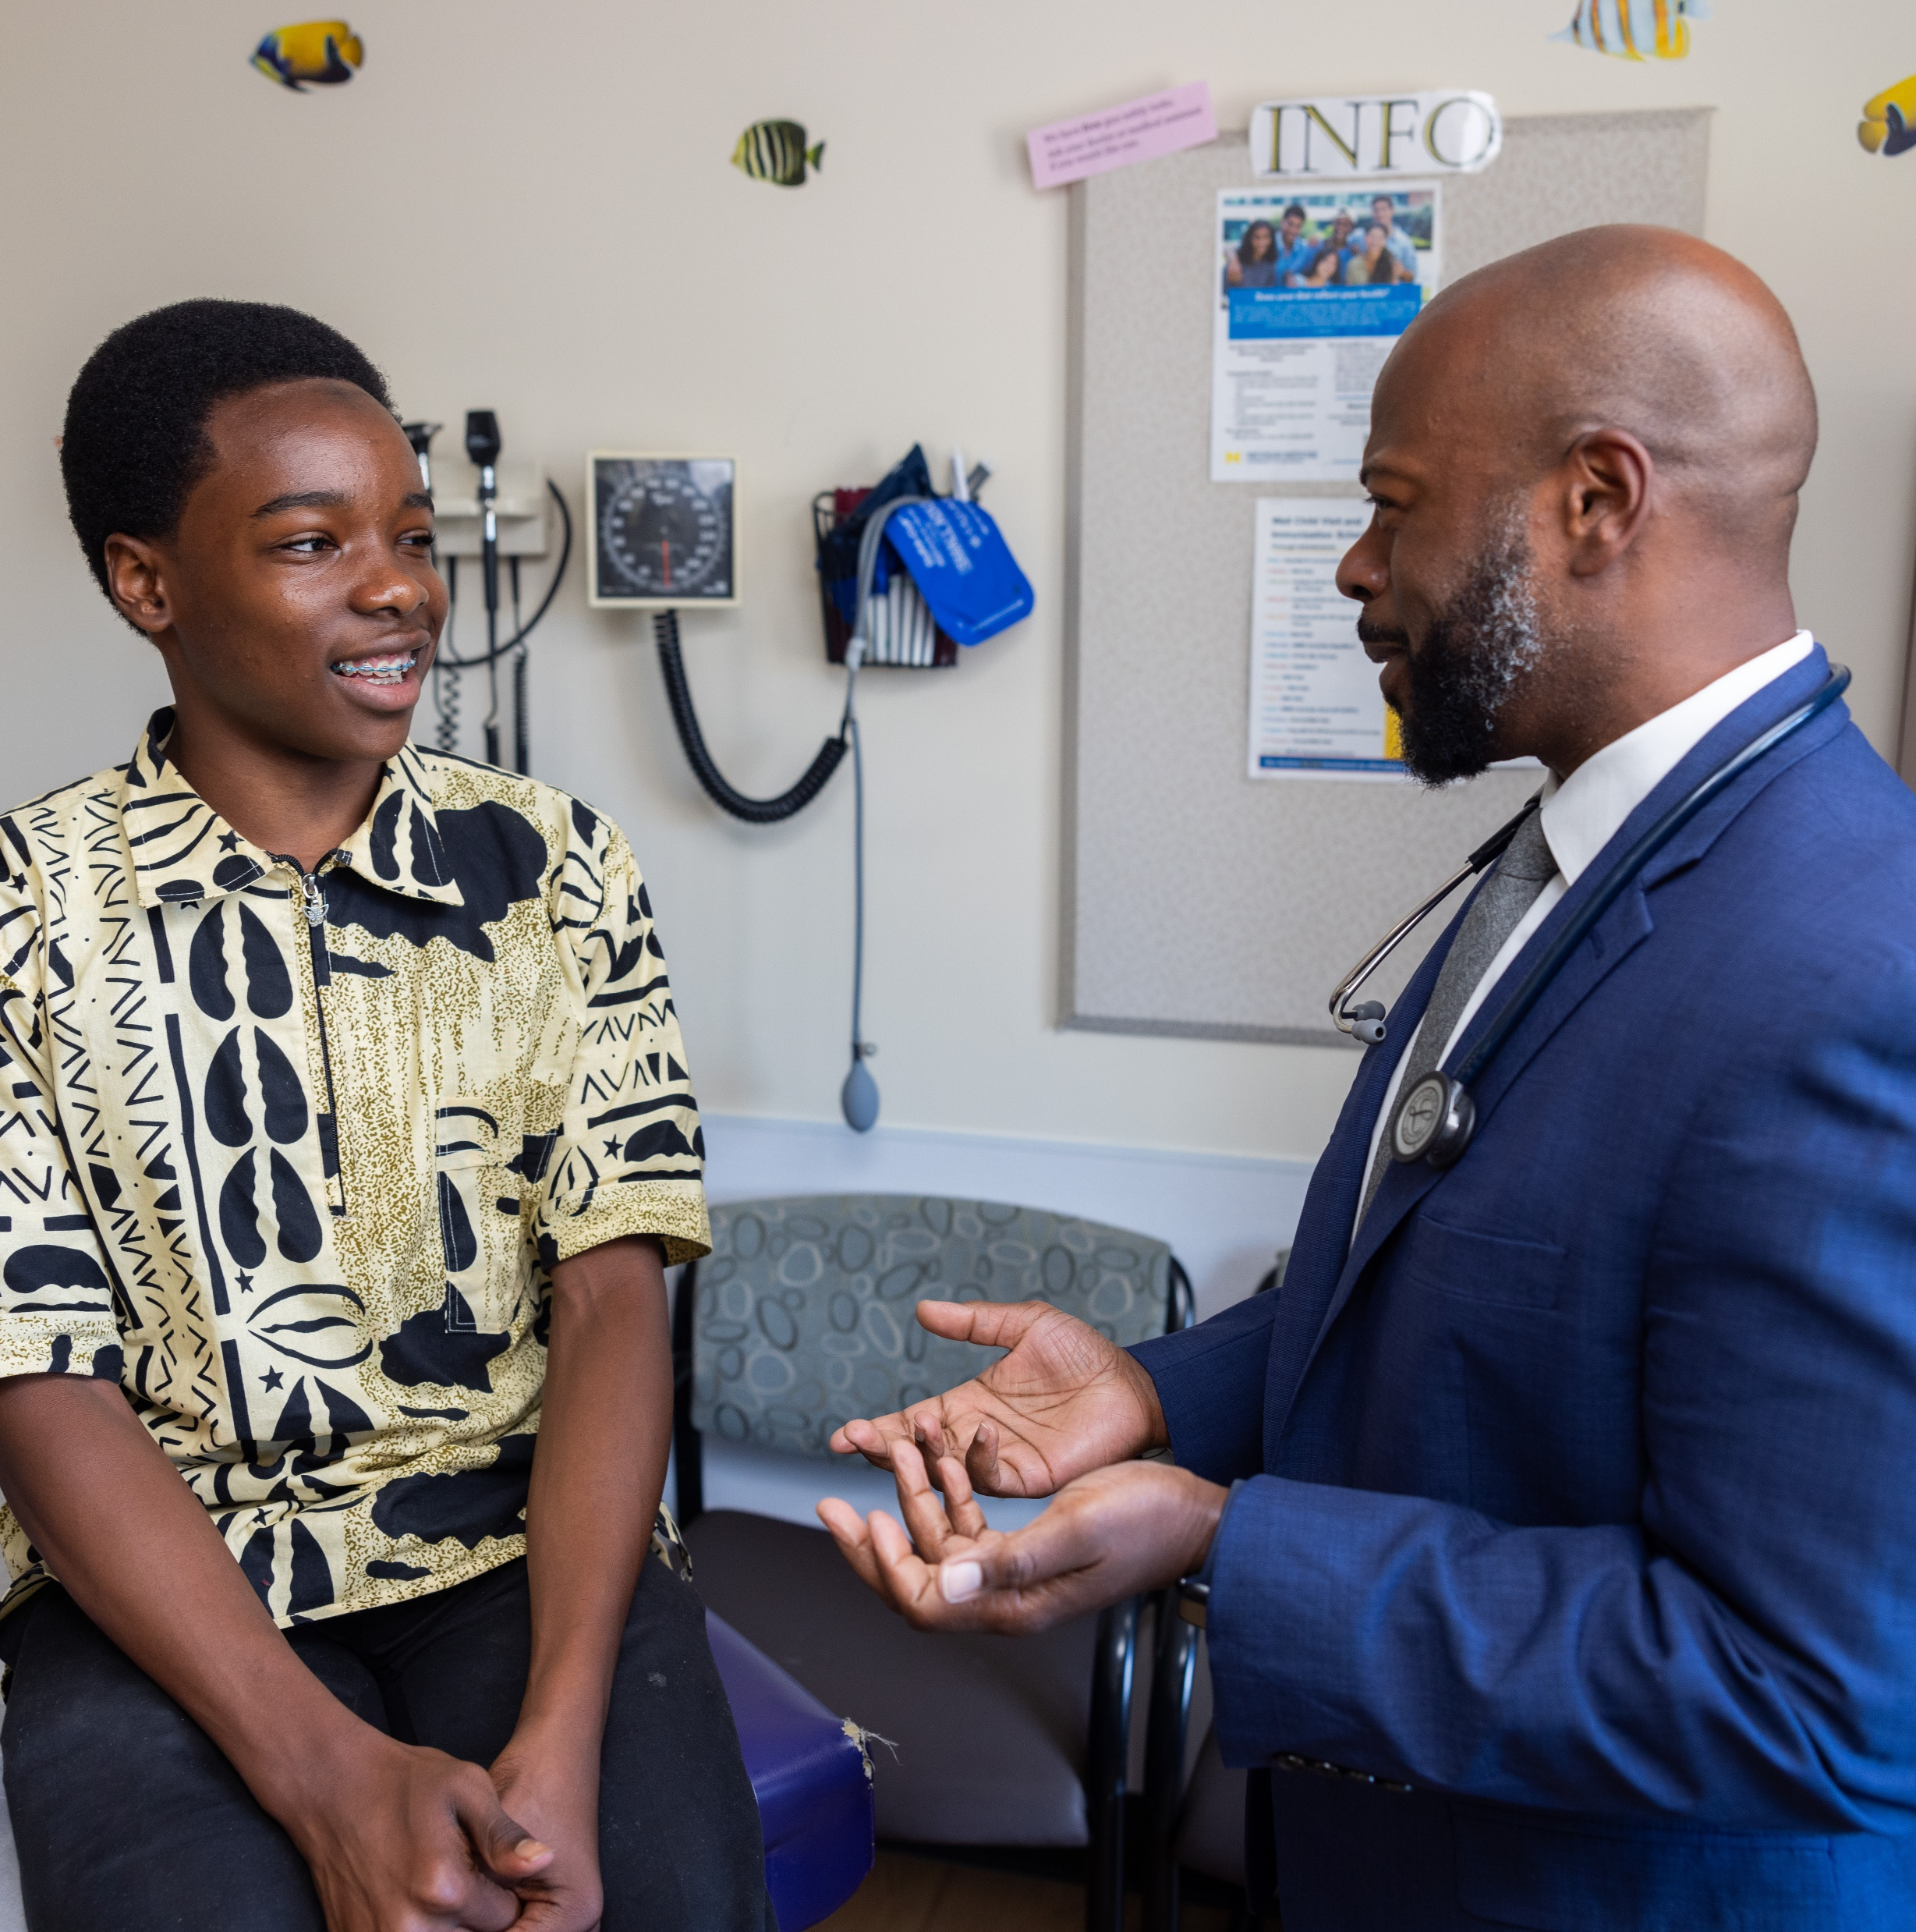
CASE SCENARIO: GIOVANNI, 17 Y/O BOY
Purpose of visit
Well visit
Issue that emerges through clinician interview
States to clinician that he’s concerned about his alcohol use
Parent information
Doesn’t want to disappoint parents
Is Giovanni allowed to get outpatient counseling for substance abuse without a parent’s consent?
Notes:
Let’s take a look at one last scenario. Giovanni is a 17-year-old boy who expresses concern about his alcohol use but doesn’t want to tell his parents.
Is Giovanni allowed to get outpatient counseling for substance use without a parent’s consent?
[Allow a moment for people to respond either quietly to themselves or aloud.]
The answer is yes, though the provider may encourage Giovanni to tell his parents.

Slide 9

Thank you!
© 2025 Regents of the University of Michigan
Notes:
To keep this conversation going over the next month, I will share Sparklers, or quiz questions, about confidentiality. I’ll post the Sparklers around the office in places that you all can easily see them. When you see a Sparkler, take a moment to read them and reflect on the responses. Thank you for your participation!
[Print and post Sparklers in areas your staff can see (e.g., lunchroom).]

