Slide 1






New jersey Minor consent and Confidentiality Laws
SPARK
For educational purposes only
Updated June 2025
© 2025 Regents of the University of Michigan
Notes:
Today we are going to do a 15-minute mini-training, also called a Spark. As youth-serving professionals, it is important that we understand adolescent confidentiality and minor consent. This training is intended to be an overview of the most relevant laws on confidential services for teens. New Jersey law is complex, so if you want to do additional learning, resources are available in the facilitator guide to this Spark.
Each person here will have times where we need to know and comply with confidentiality laws, though it’s different for our various roles. For each law and scenario we discuss, try think about how it applies to your role specifically. To get us started, let’s review a case scenario.

Slide 2

Case Scenario: SHAY, 15 Y/O girl
Purpose of visit
Sore throat
Issue that emerges from clinician interview
Concerned about having a Sexually Transmitted Infection (STI)
Parent information
Shay says she is worried her mother will kick her out of the house if she knows Shay is sexually active
Can the provider screen Shay for STIs without her mother’s consent? Why or why not?
Notes:
This is Shay who is 15. She is here today because of a sore throat. During her visit the clinician found out that she is concerned about having a STI. Shay says she is worried her mother will kick her out of the house if she knows Shay is sexually active. How does the right to confidentiality help or hurt Shay?
[Give participants a moment to respond to the question on the slide. You may choose to have discussion here or just have people think about it.]
Usually, not all of this patient information is available to everyone who comes into contact with her. When we know more details about a patient, does it affect how we feel about the patient’s right to confidentiality? Even though we know the law says we need to respect teens’ confidentiality, it can be challenging when we think parents should be involved. What can go wrong if we accidentally break confidentiality?
[Have a couple of people respond briefly. Main point: If we don’t follow the laws, it can have a negative impact on teens.]
Many teens choose to include their parent or guardian in decisions about their health. For some teens, however, having the option of certain confidential services makes it more likely that they will seek care when they need it. For instance, a sexually active teen may be more likely to use contraception if someone tells the teen that they can get birth control without a parent or guardian’s consent.

Slide 3
NJ Law: Parental Consent Exceptions
A parent or legal guardian must provide consent on behalf of a minor (under age 18) before health care services are provided, with several important exceptions:
Emergency care
Care for emancipated minors
  Minors can be emancipated by: court order, marriage, military active duty, or parenthood.
Specific health care services related to:
  Sexual health
  Mental health and substance use treatment
Notes:
Let’s review the laws and consider how we implement them here. As we see on the slide, a parent or legal guardian must provide consent on behalf of a minor (under age 18) before health services are provided, with several important exceptions:
Emergency care
Care for emancipated minors
Minors can be emancipated by: court order, marriage, military active duty, or parenthood.
Specific health care services related to:
Sexual health
Mental health and substance use treatment
[Pass out the “New Jersey Confidentiality/Minor Consent Laws” handout.]

Slide 4
NJ Law: Confidentiality/minor Consent
Patients under 18 have a right to the following without parental/guardian consent or knowledge:
Pregnancy testing and prenatal care
Birth control information, contraceptives and abortion
Testing and treatment for sexually transmitted infections (STIs), including HIV (minors aged 13+)
Substance use assessment and treatment
Outpatient mental health services (minors aged 16+)
Gender-affirming care
Notes:
Here’s a handout that explains New Jersey’s confidentiality and minor consent laws. This slide also outlines the laws and can be a cheat sheet if you want to keep it handy. As we see here, patients under 18 have a right to the following without parental/guardian consent or knowledge:
Pregnancy testing and prenatal care
Birth control information, contraceptives and abortion
Testing and treatment for sexually transmitted infections (STIs), including HIV (minors aged 13+)
Substance use assessment and treatment
Outpatient mental health services (minors aged 16+)
Gender-affirming care*
*Gender-affirming care Includes confidential, developmentally appropriate services that support a patient’s gender identity and well-being, such as:
Gender identity exploration and counseling
Mental health assessment and ongoing therapeutic support
Social affirmation support (e.g., use of chosen name and pronouns in clinical settings)
Care coordination and referrals to specialized providers when indicated
Medical interventions (such as puberty blockers or hormone therapy) are provided based on clinical guidelines, patient capacity, and applicable consent requirements, and may involve additional safeguards or caregiver involvement depending on the service and setting.
Are there any questions?

Slide 5

NJ law: Confidentiality/Minor Consent for PREP
There is no statute explicitly expressing minor consent to PrEP
Minors may consent to HIV testing and treatment
Notes:
Here is some additional information about prescribing PrEP for adolescent patients in New Jersey.
There is no statute explicitly expressing minor consent to PrEP
Minors may consent to HIV testing and treatment

Slide 6
Case Scenario: SHAY, 15 Y/O girl
Purpose of visit
Sore throat
Issue that emerges from clinician interview
Concerned about having a Sexually Transmitted Infection (STI)
Parent information
Shay says she is worried her mother will kick her out of the house if she knows Shay is sexually active
Can the provider screen Shay for STIs without her mother’s consent? Why or why not?
Notes:
Let’s go back to our 15-year-old patient scenario, Shay. Let’s answer these questions together as I read through them.
Can Shay receive STI testing without a parent’s permission? [Answer: Yes]
Can she receive STI treatment? [Answer: Yes]
What if Shay was 13 years old? Answer: [Yes, she still could, though it’s best to encourage the patient to tell her parent, and probe for signs of abuse.]

Slide 7
New Jersey Law
Health care providers must override the minor’s confidentiality and report if:
  There is suspicion of abuse or neglect by an adult
  The minor is a risk to themselves or someone else
  The minor is under age 13 and sexually active
  The provider may choose to tell the parents about any care provided to the minor patient, for a compelling medical reason
The provider may choose to tell the parents about any care provided if they believe it is in the minor’s best interest.
Minors need a parent/guardian’s permission for:
Vaccines
Mental health medications (minors 16+ can self-consent to outpatient therapy and medications)
Inpatient mental health treatment
Notes:
Now we’re going to review when a minor’s confidentiality must be overridden. Health care providers must override the minor’s confidentiality and report if:
There is suspicion of abuse or neglect by an adult
The minor is a risk to themselves or someone else
The minor is under age 13 and sexually active
The provider may choose to tell the parents about any care provided to the minor patient, for a compelling medical reason
The provider may choose to tell the parents about any care provided to the minor patient if they believe it is in the minor’s best interest.
Minors need a parent/guardian’s permission for:
Vaccines
Mental health medications (minors 16+ can self-consent to outpatient therapy and medications)
Inpatient mental health treatment

Slide 8
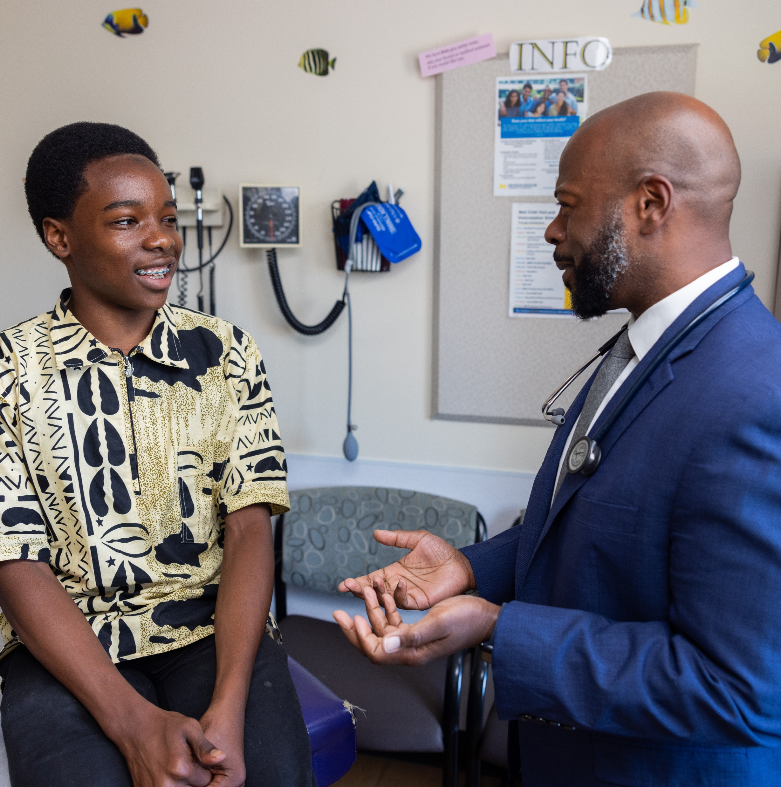
CASE SCENARIO: GIOVANNI, 17 Y/O BOY
Purpose of visit
Well visit
Issue that emerges through clinician interview
States to clinician that he’s concerned about his alcohol use
Parent information
Doesn’t want to disappoint parents
Is Giovanni allowed to get outpatient counseling for substance abuse without a parent’s consent?
Notes:
Let’s take a look at one last scenario. Giovanni is a 17-year-old boy who expresses concern about his alcohol use but doesn’t want to tell his parents.
Is Giovanni allowed to get outpatient counseling for substance use without a parent’s consent?
[Allow a moment for people to respond either quietly to themselves or aloud.]
The answer is yes, though the provider may encourage Giovanni to tell his parents.

Slide 9

Thank you!
© 2025 Regents of the University of Michigan
Notes:
To keep this conversation going over the next month, I will share Sparklers, or quiz questions, about confidentiality. I’ll post the Sparklers around the office in places that you all can easily see them. When you see a Sparkler, take a moment to read them and reflect on the responses. Thank you for your participation!
[Print and post Sparklers in areas your staff can see (e.g., lunchroom).]

