Slide 1





Florida Minor Consent and Confidentiality Laws
SPARK
For educational purposes only
Updated July 2025
© 2025 Regents of the University of Michigan
Notes:
Today we are going to do a 15-minute mini-training, also called a Spark. As youth-serving professionals, it is important that we understand adolescent confidentiality and minor consent. This training is intended to be an overview of the most relevant laws on confidential services for teens. Florida law is complex, so if you want to do additional learning, resources are available in the facilitator guide to this Spark.
Each person here will have times where we need to know and comply with confidentiality laws, though it’s different for our various roles. For each law and scenario we discuss, try think about how it applies to your role specifically. To get us started, let’s review a case scenario.

Slide 2

CASE SCENARIO: SHAY, 15 Y/O girl
Purpose of visit
Sore throat
Issue that emerges from clinician interview
Concerned about having an STI
Parent information
Shay says they are worried their mother will kick them out of the house if she knows Shay is sexually active
How does the right to confidentiality
help or hurt Shay?
Notes:
This is Shay who is 15. She is here today because of a sore throat. During her visit the clinician found out that she is concerned about having a STI. Shay says she is worried her mother will kick her out of the house if she knows Shay is sexually active. How does the right to confidentiality help or hurt Shay?
[Give participants a moment to respond to the question on the slide. You may choose to have discussion here or just have people think about it.]
Usually, not all of this patient information is available to everyone who comes into contact with her. When we know more details about a patient, does it affect how we feel about the patient’s right to confidentiality? Even though we know the law says we need to respect teens’ confidentiality, it can be challenging when we think parents should be involved. What can go wrong if we accidentally break confidentiality?
[Have a couple of people respond briefly. Main point: If we don’t follow the laws, it can have a negative impact on teens.]
Many teens choose to include their parent or guardian in decisions about their health. For some teens, however, having the option of certain confidential services makes it more likely that they will seek care when they need it. For instance, a sexually active teen may be more likely to use contraception if someone tells the teen that they can get birth control without a parent or guardian’s consent.

Slide 3
Important Definitions
Consent
Permission to act
Parent/legal guardian must give consent before their minor child can receive services (except specific confidential services)
Confidentiality
How providers and staff keep certain information confidential
Consent ≠ Confidentiality
Notes:
Before we review the laws, it’s important to recognize the difference between consent and confidentiality.
Consent is permission to act. In general, a parent/legal guardian must give their permission – or “consent” – before their minor child can receive a medical service. However, there are important exceptions where a minor can consent to their own care, without a parent/legal guardian’s permission. We will discuss these exceptions today.
Confidentiality refers to how health care providers and staff keep certain information private.
Consent does not equal confidentiality.
o Even if a minor is allowed to consent to a service without a parent/legal guardian’s permission, it does not necessarily mean that the provider is required to keep it confidential.
o So, laws can protect a minor’s right to access a specific service, like contraception, but often, it’s up to health care providers and staff to protect a minor’s confidentiality.

Slide 4
FL Law: parental Consent Exceptions
A parent or legal guardian must provide consent on behalf of a minor (under age 18) before health care services are provided, with several important exceptions:
Emergency care
Emancipated minors (age 16+, self-supporting and living apart; or married; or tried as an adult)
Pregnancy related services: test, prenatal/postnatal care, delivery
  Unmarried pregnant minors can only consent to services related to their pregnancy; cannot consent to medical/surgical care for themselves
A minor mother can consent to care for their child, but not for unrelated care for themselves
STI/HIV services: testing, treatment, and related counseling
Substance use assessment and outpatient treatment
Outpatient mental health
  Diagnostic/crisis care for minors 13+
  Limited to 2 visits per week (excludes medications or residential care)
Notes:
Let’s review the laws and consider how we implement them here. As we see on the slide, a parent or legal guardian must provide consent on behalf of a minor (under age 18) before health services are provided, with several important exceptions:
Emergency care
Emancipated minors (age 16+, self-supporting living apart; or married; or tried as an adult)
Pregnancy related services: test, prenatal/postnatal care, delivery
Unmarried pregnant minors can only consent to medical/surgical services related to their pregnancy; cannot consent to medical/surgical care for themselves
A minor mother can consent to care for their child, but not for unrelated care for themselves
STI/HIV services: testing, treatment, and related counseling
Substance use assessment and outpatient treatment
Outpatient mental health
Diagnostic/crisis care for minors 13+
Limited to 2 visits per week (excludes medications or residential care)
[Pass out the “Florida Minor Consent & Confidentiality Laws” handout.]

Slide 5
FL Law: Confidentiality/Minor Consent
Patients under 18 have a right to the following without parental/guardian consent or knowledge:
  Pregnancy and prenatal care
  Testing and treatment for STIs, including HIV
  Substance use assessment and outpatient treatment
  Outpatient mental health services: ages 13 and up, limited to short-term diagnostic/evaluative care (up to 2 visits/week); parental consent required for ongoing therapy or medications
Notes:
Here’s a handout that explains Florida’s confidentiality and minor consent laws. This slide also outlines the laws and can be a cheat sheet if you want to keep it handy. As we see here, patients under 18 have a right to the following without parental/guardian consent or knowledge:
Pregnancy and prenatal care
Testing and treatment for STIs, including HIV
Substance use assessment and outpatient treatment
Outpatient mental health services: ages 13 and up, limited to short-term diagnostic/evaluative care (up to 2 visits/week); parental consent required for ongoing therapy or medications
Are there any questions?

Slide 6
FL Law: Confidentiality/Minor Consent for Prep
DOH CHD programs require parental consent for PrEP; community providers may have variable policies. Consult legal/risk management and DOH for institutional policy
  Florida DOH PrEP Clinical Guidelines (July 2022) state: “Adolescents may not be provided PrEP in our county health department (CHD) programs unless parental consent is obtained. Refer adolescents to community providers for PrEP initiation.” This means DOH-run clinics must get parental consent before prescribing PrEP.
Notes:
This slide highlights how PrEP consent works for minors in Florida. First, for any Florida Department of Health county health department programs, clinics run directly by DOH, parental consent is required before a minor can be prescribed PrEP. That comes directly from the Florida DOH PrEP Clinical Guidelines from July 2022, which also recommend that minors be referred to community providers for PrEP initiation.
For community providers outside of DOH, policies can vary because Florida law doesn’t explicitly allow minors to consent to PrEP on their own. The safest approach is to check your organization’s legal or risk management guidance and, if needed, consult the DOH before prescribing PrEP to minors.
In short, DOH clinics require parental consent and community clinics may have flexibility, but always confirm policies to stay within best practices.

Slide 7
CASE SCENARIO: SHAY, 15 Y/O Girl
Purpose of visit
Sore throat
Issue that emerges from clinician interview
Concerned about having an STI
Parent information
Shay says they are worried their mother will kick them out of the house if she knows Shay is sexually active
Can Shay receive STI testing without their parent/legal guardian’s permission?
Can Shay receive STI treatment without their parent/legal guardian’s permission?
Can Shay receive contraception without their parent/legal guardian’s permission?
Notes:
Let’s go back to our 15-year-old patient scenario, Shay. Let’s answer these questions together as I read through them
Can Shay receive STI testing without a parent’s permission? [Answer: Yes]
Can Shay receive STI treatment? [Answer: Yes]
Can Shay receive contraception without her parent/legal guardian’s permissions? [Answer: According to the law, only minors who are married, pregnant, or a parent can consent to contraception unless the provider believes that not prescribing contraception will impose an “immediate health hazard” to the patient.]

Slide 8
Legislation Updates
AS OF JULY 1, 2020:
Abortion:
For minors requesting an abortion, provider must obtain written parental/legal guardian consent.
Prior to this law, providers were mandated to provide a 48-hour notice to parents/legal guardians, prior to performing the abortion.
Notes:
Senate Bill 404, effective July 1, 2020, requires written, notarized parental or legal guardian consent before performing an abortion on a minor (under 18).
Exceptions apply when:
A judge grants a judicial waiver, finding the minor mature enough or that involving a parent/guardian is not in their best interest.
A medical emergency makes it unsafe to delay the procedure for consent.

Slide 9
legislation Updates
AS OF JULY 1, 2020:
Pelvic Examinations:
A provider must obtain written consent from the patient or their parent/legal guardian to perform any pelvic examination unless:
By court orders the performance of an examination OR
Is immediately necessary to avoid serious risk
Notes:
Senate Bill 698, effective July 1, 2020, continues to require written consent from the patient or legal guardian prior to performing any pelvic examinations in Florida.
Exceptions apply when:
The examination is court-ordered for evidence collection.
The examination is immediately necessary to avoid serious risk.

Slide 10
legislation Update: Parent bill of rights
AS OF JULY 2021:
Health care providers are required to obtain written consent from a parent or legal guardian before providing medical services, prescribing medication, or performing procedures on a minor, unless another state law specifically allows a minor to consent on their own.
Under this law, parental/legal guardian rights include:
The right to make medical decisions for their child, unless otherwise prohibited by law
The right to access and review their child’s medical records
*According to the Florida Medical Association’s General Counsel, the phrase “except as otherwise provided by law” only exempts services where statutes explicitly permit minor consent (e.g., for STI testing/treatment, pregnancy care, etc.).
Notes:
Florida House Bill 241, effective July 1, 2021, requires health care providers to obtain written parental or legal guardian consent before providing services, prescribing medications, or performing medical procedures on a minor, unless another law explicitly allows the minor to consent on their own.
Therefore, all services that minors are legally allowed to consent to under Florida law (e.g., STI testing/treatment, substance use care, pregnancy-related services, limited mental health evaluation) remain unaffected by HB 241.
While minors may consent to certain components of care such as outpatient mental health counseling, services like psychotropic medications or ongoing therapy still require parental consent under HB 241. In these cases, parents/legal guardians may access related medical records, though some parts (e.g., confidential therapy notes) may remain protected, while others (e.g., prescriptions) are accessible.
For more information on the Parent Bill of Rights:
https://miamimed.com/news/572974/Treating-minors-under-Floridas-new-parental-consent-law.htm
https://www.myfloridahouse.gov/Sections/Bills/billsdetail.aspx?BillId=70313

Slide 11

Hpv vaccines & mental health medications
Notes:
Can a minor in the state of Florida give consent for the HPV vaccine?
The answer in Florida is no. A minor cannot consent for the HPV vaccine. To receive any vaccine, including HPV, a parent or legal guardian must provide written consent and must sign that they received the Vaccine Information Statement (VIS).
On your handout, you’ll see this toward the bottom. Note that mental health medications also require a parent or legal guardian’s consent.

Slide 12
Reporting
Providers must override a minor’s confidentiality and report if:
If the minor poses a danger to self or others
There is suspicion of abuse or neglect
Sexual activity occurred that was without consent, involved coercion, or was not between peers of the similar age or developmental stage
The minor is under age 16 and has been sexually active with an adult age 24 or over
Notes:
Now we’re going to review when a minor’s confidentiality must be overridden. Health care providers must override the minor’s confidentiality and report…
If the minor poses a danger to self or others
There is suspicion of abuse or neglect
Sexual activity occurred that was without consent, involved coercion, or was not between peers of similar age or developmental stage
The minor is under age 16 and has engaged in sexual activity with an adult age 24 or older (statutory rape under Florida law)
Again, this part of the law allows a provider to tell a parent/legal guardian about these specific confidential services if it’s in the best interest of the young person

Slide 13
CASE SCENARIO: SHAY, 15 Y/O (she/her)
Information regarding consultation, examination, or treatment for a STI provided to a minor may NOT be disclosed to a parent without the teen’s consent.
If Shay’s mother calls the clinic to ask if Shay received an STI test, can this information be released?
Are there other ways that Shay’s mother could find out that Shay received this service?
Notes:
If Shay’s mother calls the clinic to ask if Shay received an STI test, can this information be released?
[Answer: No. Florida law specifically protects the confidentiality of STI services for minors and prohibits health care providers from disclosing information related to STI consultation, examination, or treatment—either directly or indirectly—without the minor’s consent.]
Are there other ways that Shay’s mother could find out that Shay received this service?
[Answer: No, she shouldn’t—Florida law prohibits disclosing STI services in any direct or indirect way, including through billing. If Shay uses their caregiver’s health insurance, an Explanation of Benefits (EOB) is typically generated and sent to the policyholder, which can include details about services received. However, Florida law prohibits STI testing or treatment information from appearing on EOBs unless the minor provides explicit permission.
That said, confidentiality can still be compromised in other ways—like through out-of-pocket payments, copays, or clinic communications.
For maximum confidentiality, minors should be referred to providers who do not bill insurance and can offer confidential services—such as Title X clinics. For more strategies, refer to the Spark on Confidentiality Best Practices.]

Slide 14
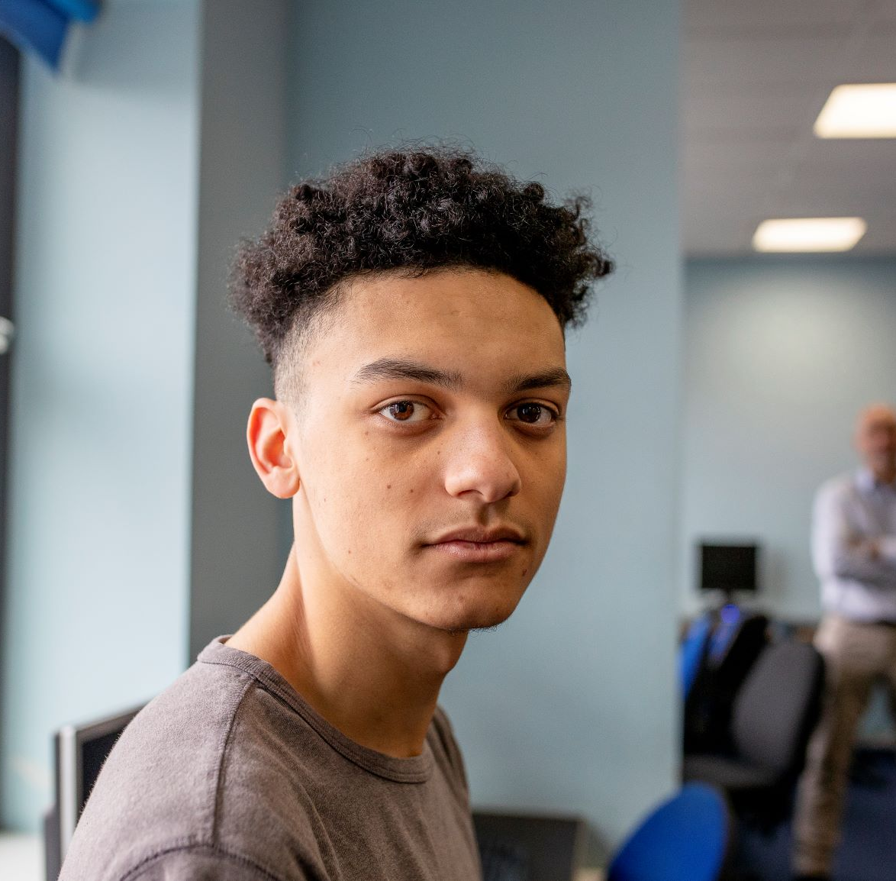
CASE SCENARIO: GIOVANNI, 17 Y/O (He/him)
Purpose of visit
Well visit
Issue that emerges through clinician interview
States to clinician that he’s ready to get treatment for a substance use disorder
Parent information
Doesn’t want to disappoint family
Is Giovanni allowed to get outpatient counseling for substance use without a parent/legal guardian’s consent?
Notes:
Let’s take a look at one last scenario. Giovanni is a 17-year-old who is struggling with a substance use disorder but doesn’t want to tell his family. Is Giovanni allowed to get outpatient counseling for substance use without a parent/legal guardian’s consent?
[Allow a moment for people to respond either silently to themselves or aloud.]
The answer is yes. Under Florida law, a minor may consent to outpatient care, treatment, or rehabilitation for substance use without the consent of a parent or legal guardian. Additionally, the law requires that written consent from the minor must be obtained before any information is disclosed to a parent or legal guardian.

Slide 15

Thank you!
© 2025 Regents of the University of Michigan
Notes:
To keep this conversation going over the next month, I will share Sparklers, or quiz questions, about confidentiality. I’ll post the Sparklers around the office in places that you all can easily see them. When you see a Sparkler, take a moment to read them and reflect on the responses. Thank you for your participation!
[Print and post Sparklers in areas your staff can see (e.g., lunchroom).]

